Slide 1
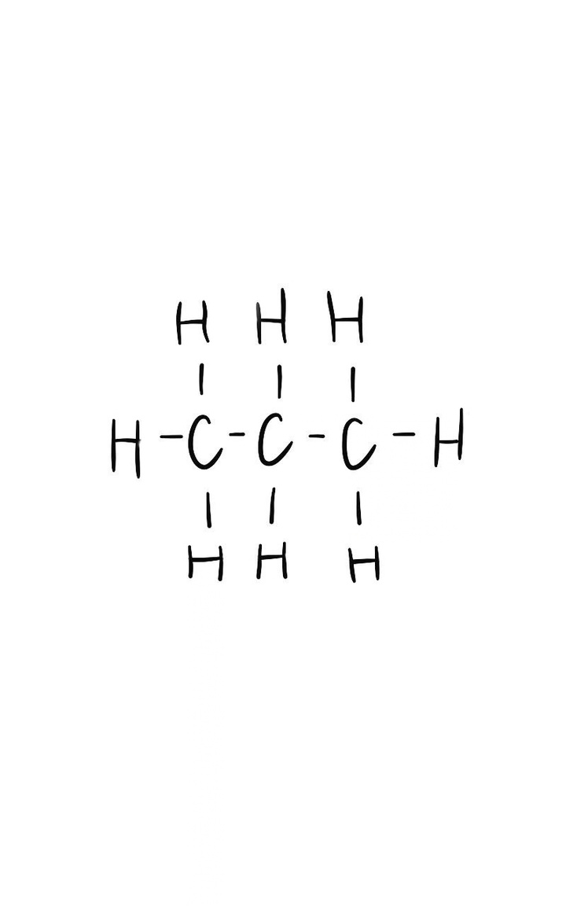

PROPANE
CARD 01 - C₃H₈
MOLECULAR FORMULA | LEWIS STRUCTURE
C₃H₈
CONDENSED STRUCTURAL FORMULA | BOND-LINE FORMULA
CH₃CH₂CH₃
VERIFICATION STRIP
ATOM COUNT VERIFIED VALENCE CHECKED
BOND ODER CHECKED SAME CONNECTIVITY CONFIRMED

Slide 2
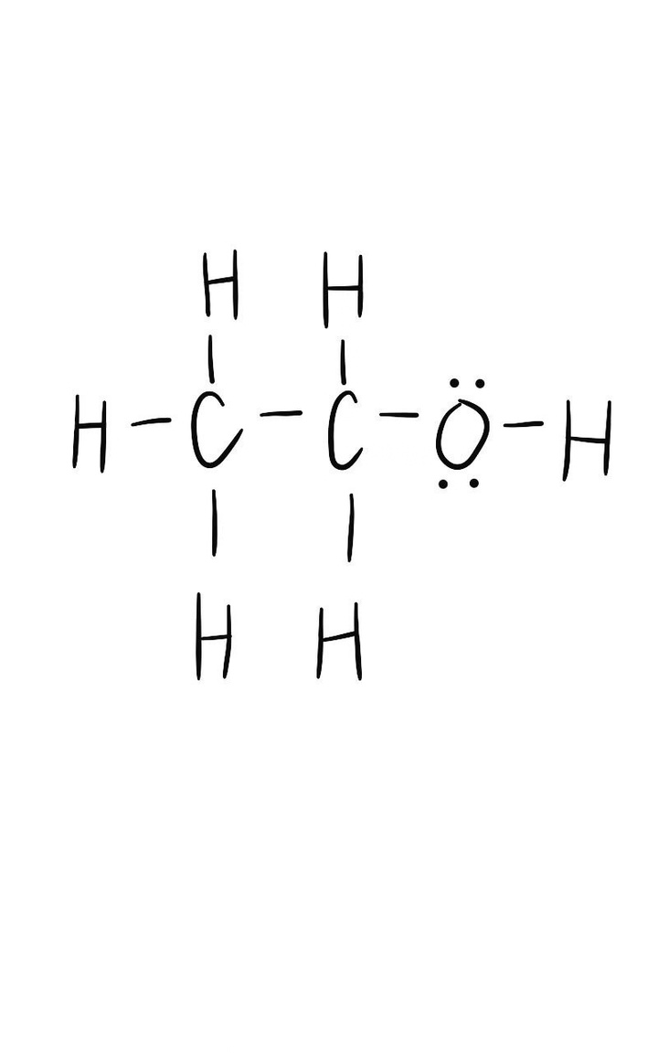

ETHANOL
CARD 02 - C₂H₆O
MOLECULAR FORMULA | LEWIS STRUCTURE
C₂H₆O
CONDENSED STRUCTURAL FORMULA | BOND-LINE FORMULA
CH₃CH₂OH
VERIFICATION STRIP
ATOM COUNT VERIFIED VALENCE CHECKED
BOND ODER CHECKED SAME CONNECTIVITY CONFIRMED

Slide 3
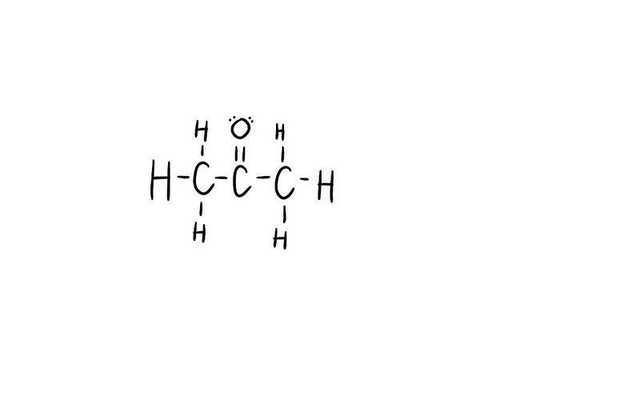

ACETONE
CARD 03 - C₃H₆O
MOLECULAR FORMULA | LEWIS STRUCTURE
C₃H₆O
CONDENSED STRUCTURAL FORMULA | BOND-LINE FORMULA
CH₃COCH₃
VERIFICATION STRIP
ATOM COUNT VERIFIED VALENCE CHECKED
BOND ODER CHECKED SAME CONNECTIVITY CONFIRMED

Slide 4
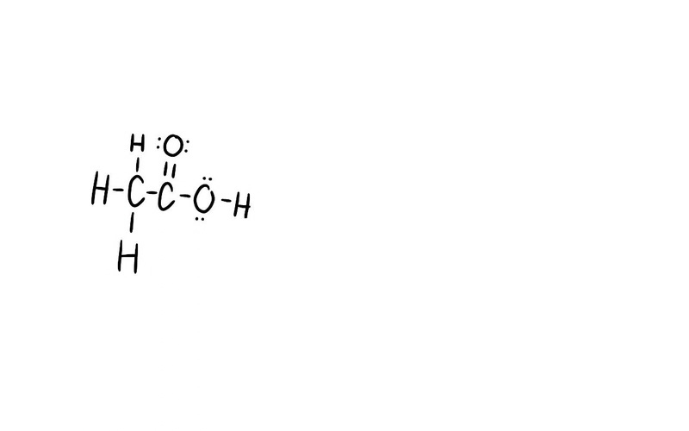

ACETIC ACID
CARD 04 - C₂H₄O₂
MOLECULAR FORMULA | LEWIS STRUCTURE
C₂H₄O₂
CONDENSED STRUCTURAL FORMULA | BOND-LINE FORMULA
CH₃COOH
VERIFICATION STRIP
ATOM COUNT VERIFIED VALENCE CHECKED
BOND ODER CHECKED SAME CONNECTIVITY CONFIRMED

Slide 5
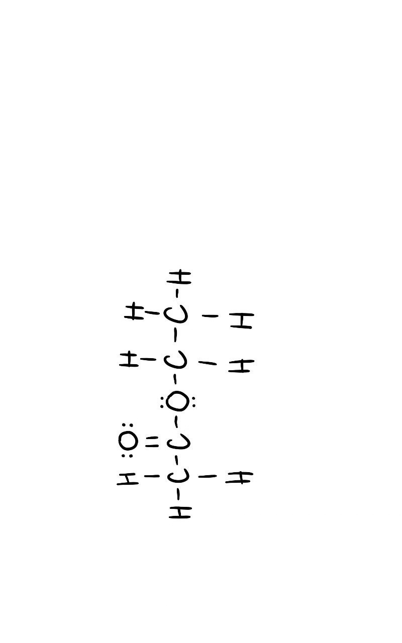

ETHYL ACETATE
CARD 05 - C₄H₈O₂
MOLECULAR FORMULA | LEWIS STRUCTURE
C₄H₈O₂
CONDENSED STRUCTURAL FORMULA | BOND-LINE FORMULA
CH₃COOCH₂CH₃
VERIFICATION STRIP
ATOM COUNT VERIFIED VALENCE CHECKED
BOND ODER CHECKED SAME CONNECTIVITY CONFIRMED

Slide 6
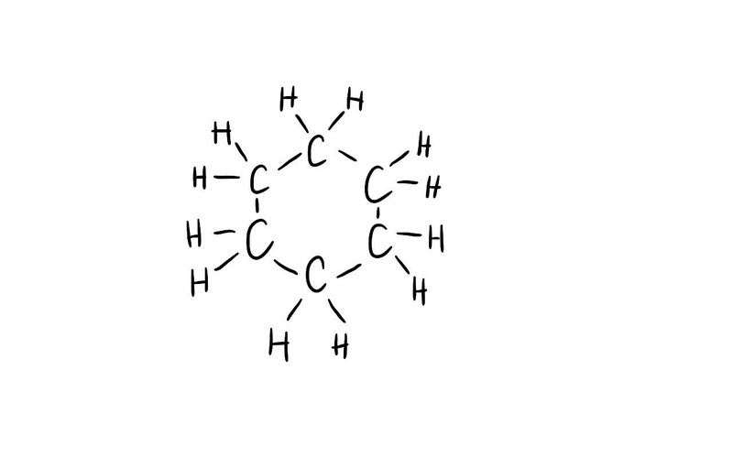

CYCLOHEXANE
CARD 06 - C₆H₁₂
MOLECULAR FORMULA | LEWIS STRUCTURE
C₆H₁₂
CONDENSED STRUCTURAL FORMULA | BOND-LINE FORMULA
(CH₂)₆
VERIFICATION STRIP
ATOM COUNT VERIFIED VALENCE CHECKED
BOND ODER CHECKED SAME CONNECTIVITY CONFIRMED

Slide 7
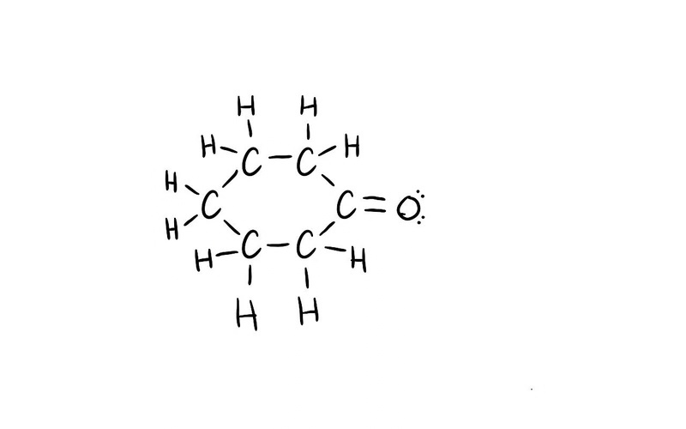

CYCLOHEXANONE
CARD 07 - C₆H₁₀O
MOLECULAR FORMULA | LEWIS STRUCTURE
C₆H₁₀O
CONDENSED STRUCTURAL FORMULA | BOND-LINE FORMULA
(CH₂)₅CO
VERIFICATION STRIP
ATOM COUNT VERIFIED VALENCE CHECKED
BOND ODER CHECKED SAME CONNECTIVITY CONFIRMED

Slide 8
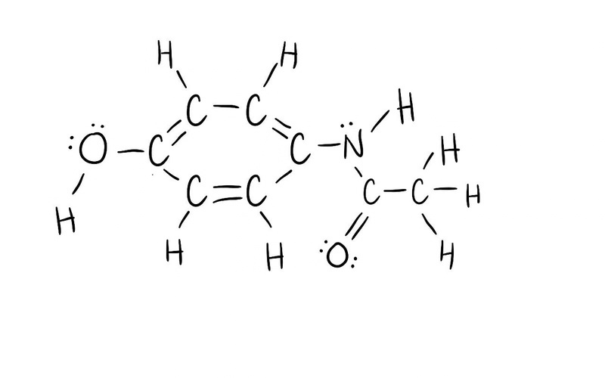
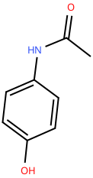
ACETAMINOPHEN
CARD 08 - C₈H₉NO₂
MOLECULAR FORMULA | LEWIS STRUCTURE
C₈H₉NO₂
CONDENSED STRUCTURAL FORMULA | BOND-LINE FORMULA
HOC₆H₄NHCOCH₃
VERIFICATION STRIP
ATOM COUNT VERIFIED VALENCE CHECKED
BOND ODER CHECKED SAME CONNECTIVITY CONFIRMED

Slide 9
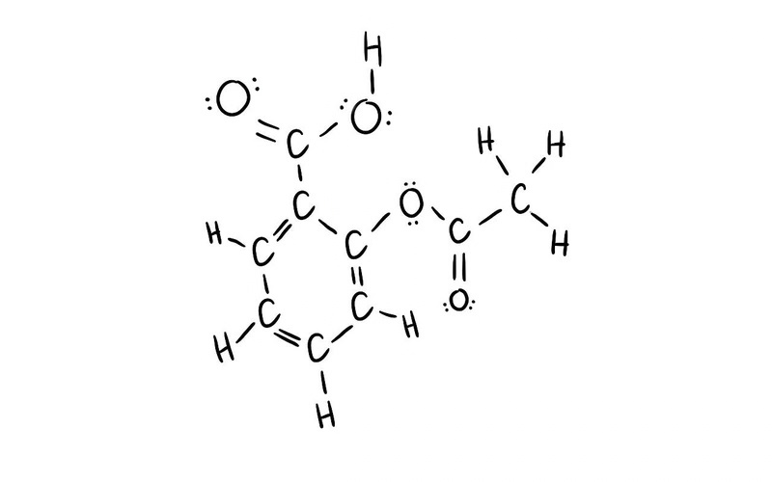
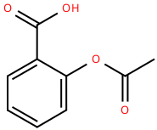
ASPIRIN
CARD 09 - C₉H₈O₄
MOLECULAR FORMULA | LEWIS STRUCTURE
C₉H₈O₄
CONDENSED STRUCTURAL FORMULA | BOND-LINE FORMULA
CH₃COOC₆H₄COOH
VERIFICATION STRIP
ATOM COUNT VERIFIED VALENCE CHECKED
BOND ODER CHECKED SAME CONNECTIVITY CONFIRMED

Slide 10
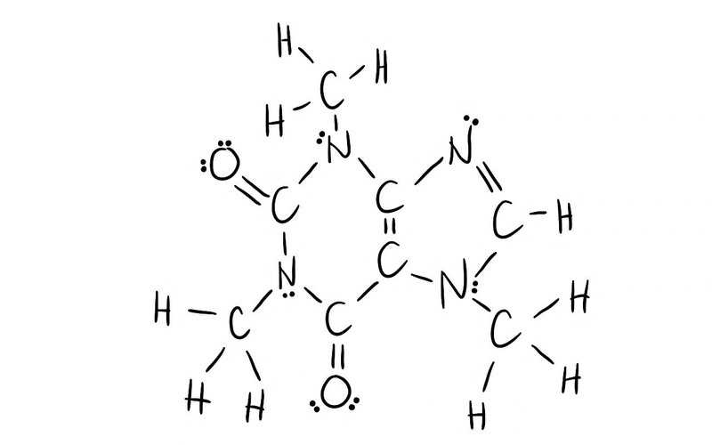
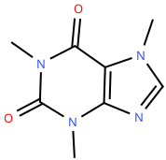
CAFFEINE
CARD 10 - C₈H₁₀N₄O₂
MOLECULAR FORMULA | LEWIS STRUCTURE
C₈H₁₀N₄O₂
CONDENSED STRUCTURAL FORMULA | BOND-LINE FORMULA
(CH₃N–C=O)₂C=C(N=CH–NCH₃)
VERIFICATION STRIP
ATOM COUNT VERIFIED VALENCE CHECKED
BOND ODER CHECKED SAME CONNECTIVITY CONFIRMED

Slide 11
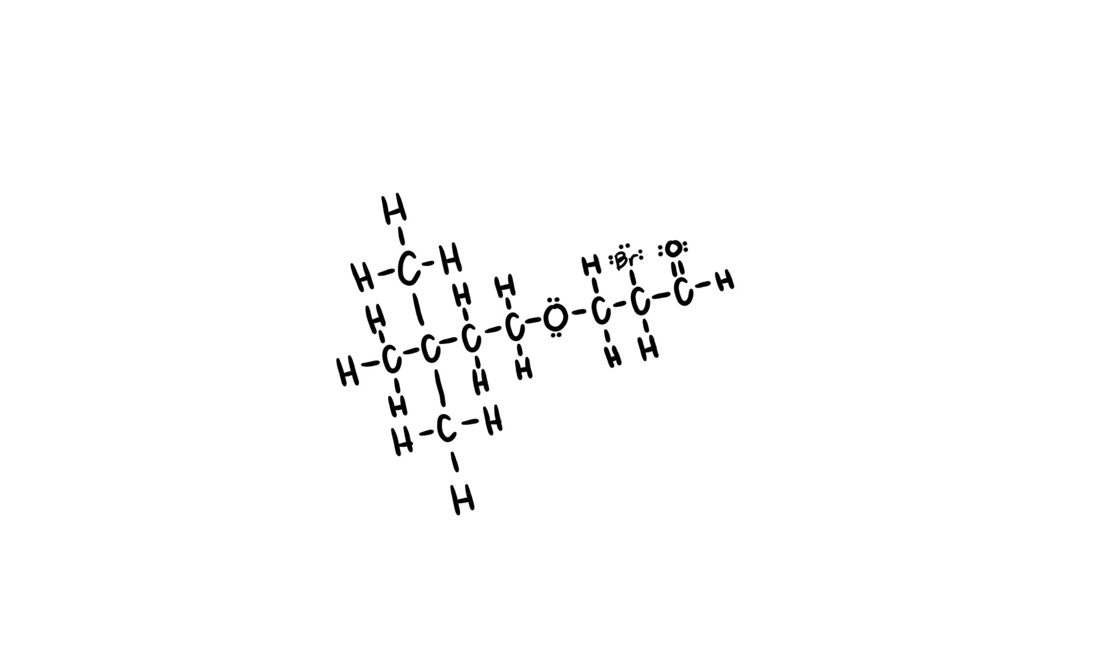
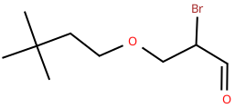
2-BROMO-3-(3,3-DIMETHYLBUTOXY)PROPANAL
CARD 11 - PROBLEM 1
MOLECULAR FORMULA | LEWIS STRUCTURE
C₉H₁₇BrO₂
CONDENSED STRUCTURAL FORMULA | BOND-LINE FORMULA
(CH₃)₃CCH₂CH₂OCH₂CH(Br)CHO
VERIFICATION STRIP
ATOM COUNT VERIFIED VALENCE CHECKED
BOND ODER CHECKED SAME CONNECTIVITY CONFIRMED

Slide 12
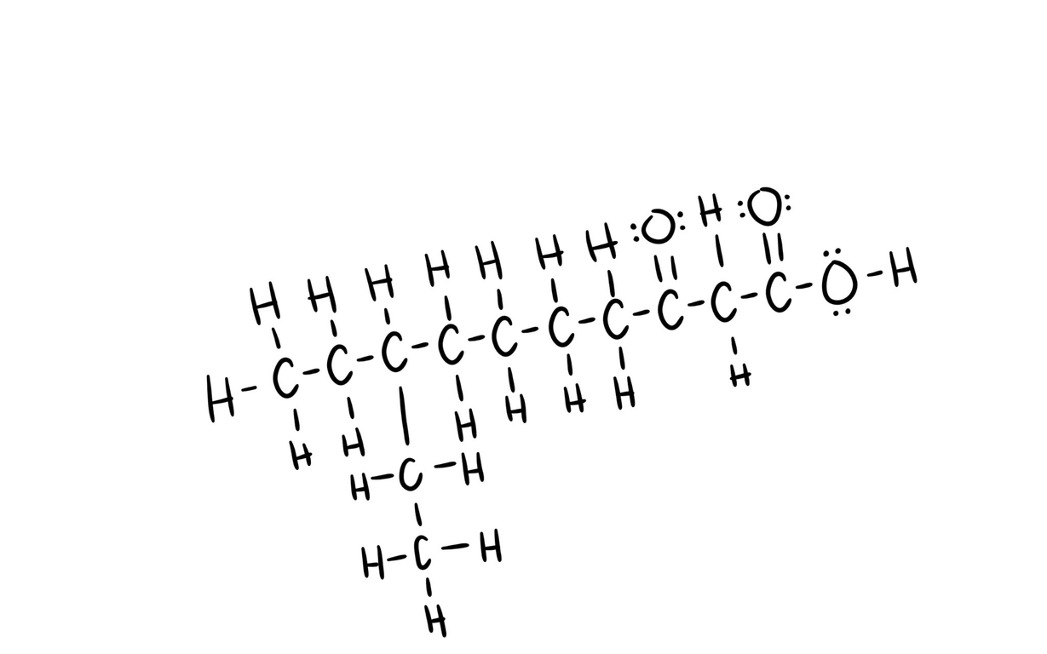
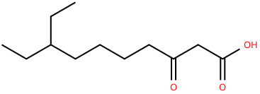
8-ETHYL-3-OXODECANOIC ACID
CARD 12 - PROBLEM 2
MOLECULAR FORMULA | LEWIS STRUCTURE
C₁₂H₂₂O₃
CONDENSED STRUCTURAL FORMULA | BOND-LINE FORMULA
CH₃CH₂CH(C₂H₅)(CH₂)₄COCH₂COOH
VERIFICATION STRIP
ATOM COUNT VERIFIED VALENCE CHECKED
BOND ODER CHECKED SAME CONNECTIVITY CONFIRMED

Slide 13
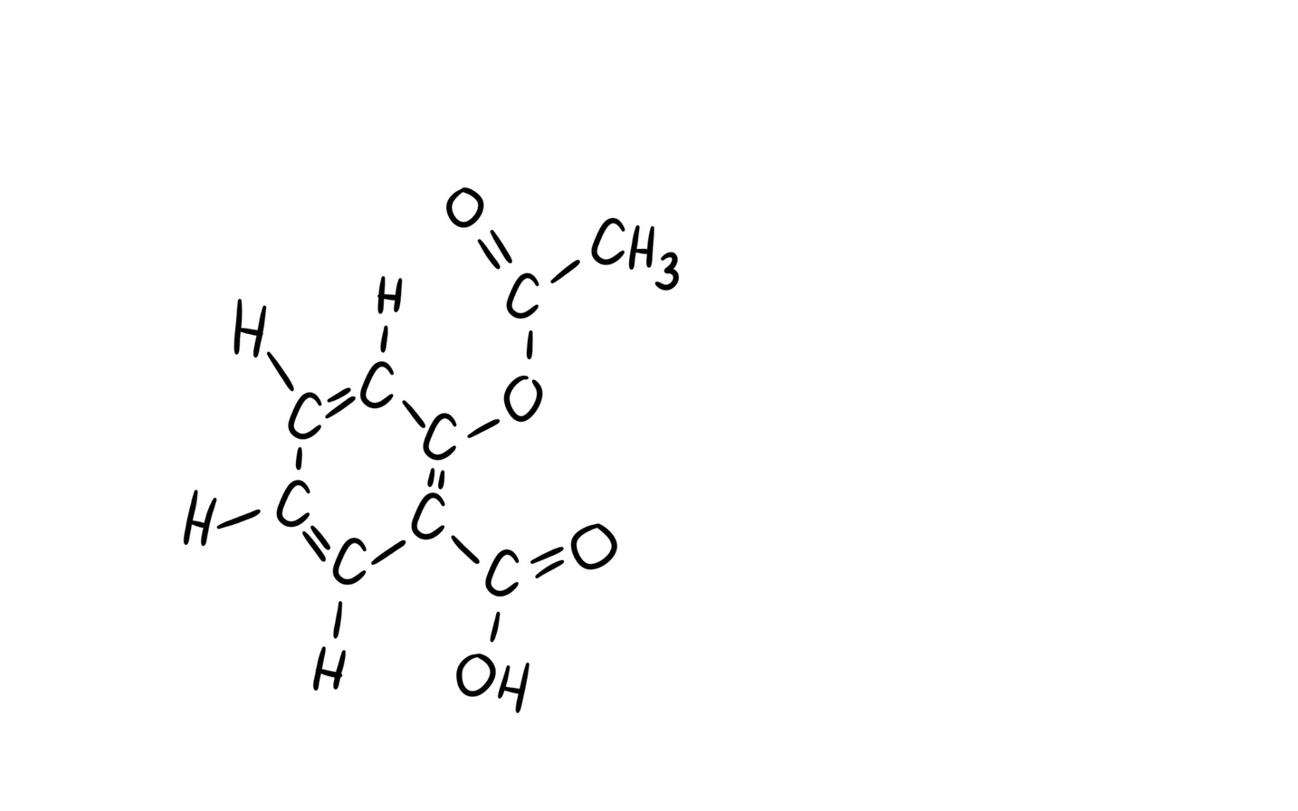
ACETYLSALICYLIC ACID
CARD 13 - PROBLEM 3
MOLECULAR FORMULA | LEWIS STRUCTURE
C₉H₈O₄
CONDENSED STRUCTURAL FORMULA | BOND-LINE FORMULA
CH₃COOC₆H₄COOH
VERIFICATION STRIP
ATOM COUNT VERIFIED VALENCE CHECKED
BOND ODER CHECKED SAME CONNECTIVITY CONFIRMED

Slide 14
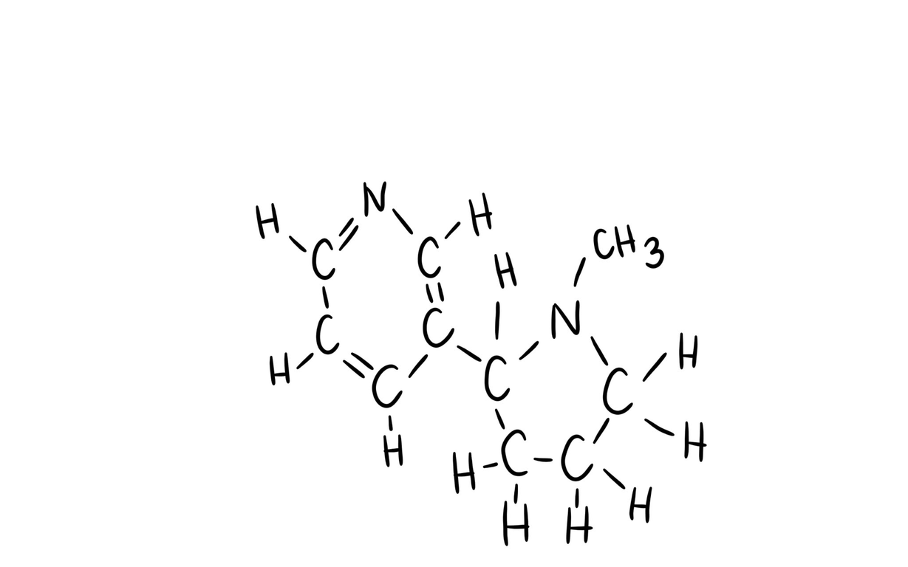
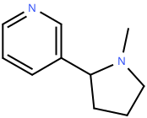
NICOTINE
CARD 14 - PROBLEM 4
MOLECULAR FORMULA | LEWIS STRUCTURE
C₁₀H₁₄N₂
CONDENSED STRUCTURAL FORMULA | BOND-LINE FORMULA
C₅H₄N–C₄H₇NCH₃
VERIFICATION STRIP
ATOM COUNT VERIFIED VALENCE CHECKED
BOND ODER CHECKED SAME CONNECTIVITY CONFIRMED

Slide 15
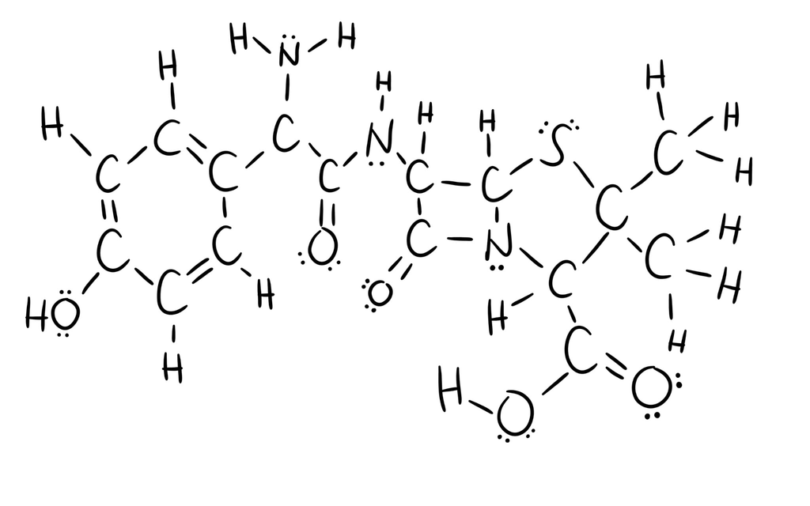
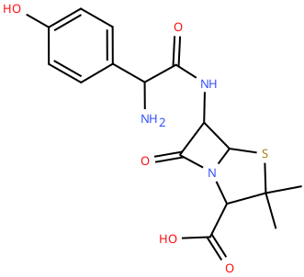
AMOXICILLIN
CARD 15 - PROBLEM 5
MOLECULAR FORMULA | LEWIS STRUCTURE
C₁₆H₁₉N₃O₅S
CONDENSED STRUCTURAL FORMULA | BOND-LINE FORMULA
(HOC₆H₄)CH(NH₂)CONH · [C₄H₃NOS] · C(CH₃)₂COOH
VERIFICATION STRIP
ATOM COUNT VERIFIED VALENCE CHECKED
BOND ODER CHECKED SAME CONNECTIVITY CONFIRMED

